Slide 1
Japan’s Indo-Pacific Game Plan How is Euro-Atlantic connected?
Romanian-American University
20 June 2024
Professor Dr Kei HAKATA
Seikei University
hakata@fh.seikei.ac.jp

Slide 2
About Seikei University
Rooted in a private educational institution founded in 1912
The private university located in the Western Tokyo city of Kichijoji
Partnership and exchange programme with Romanian-American University
Alumni include the late PM Shinzo Abe
Image: Seikei Gakuen

Slide 3
Images: Seikei Gakuen

Slide 4
The new Faculty of Global Studies and Sustainability will welcome students in April 2026
Image: Seikei University

Slide 5
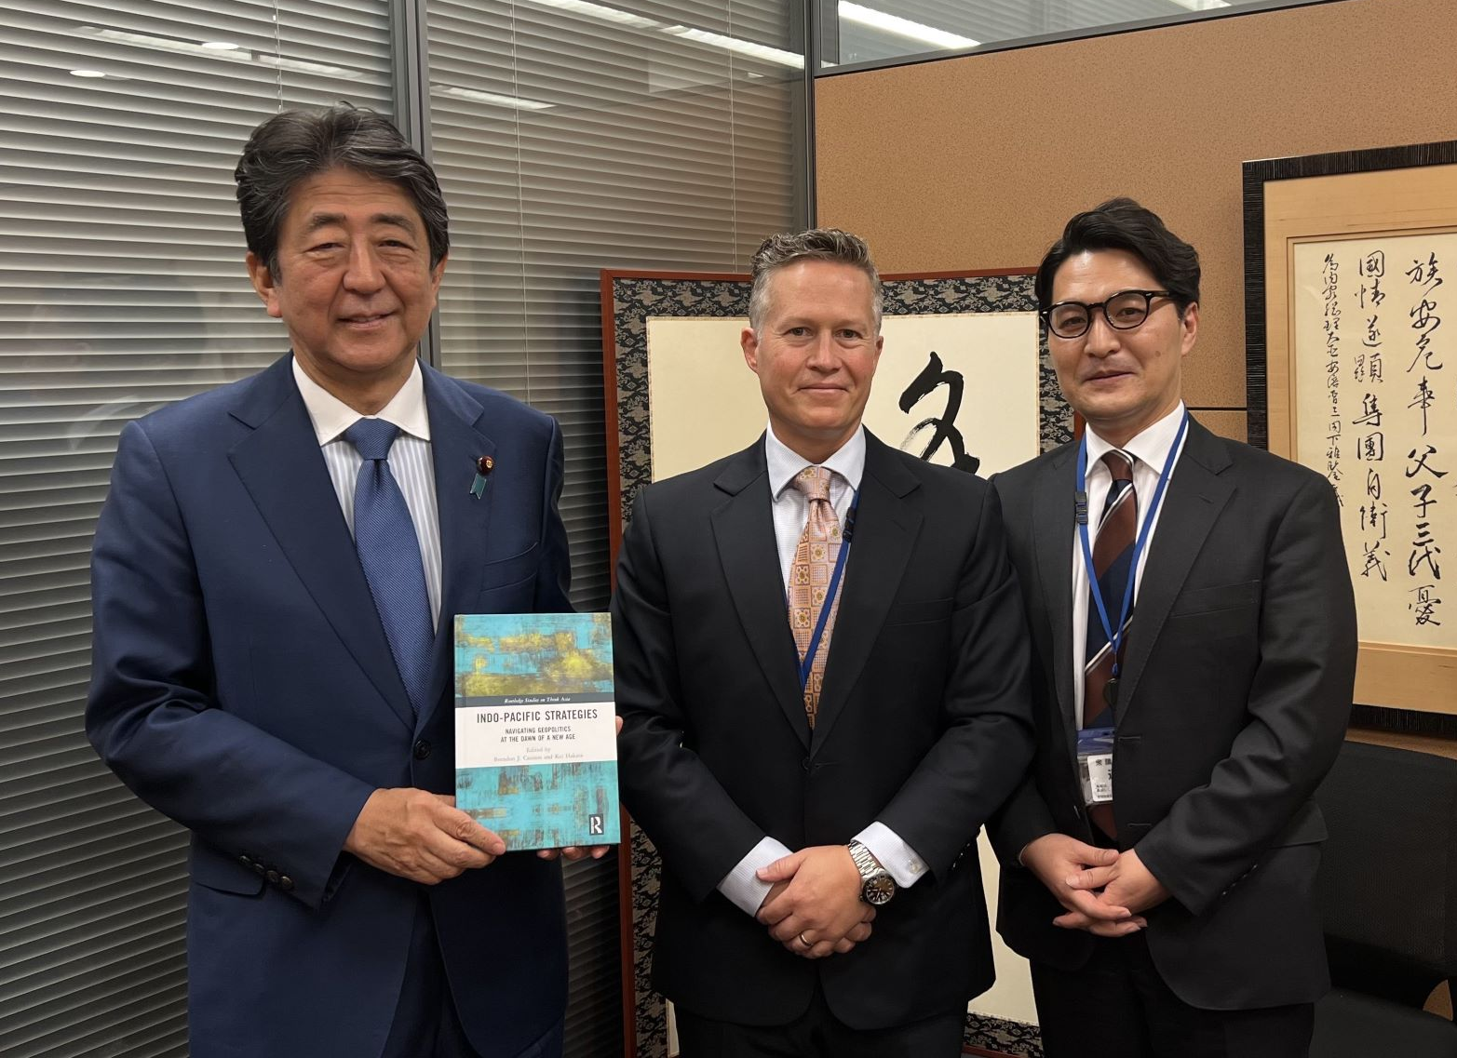
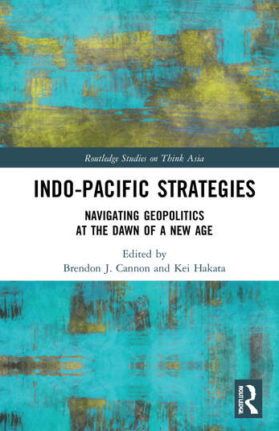
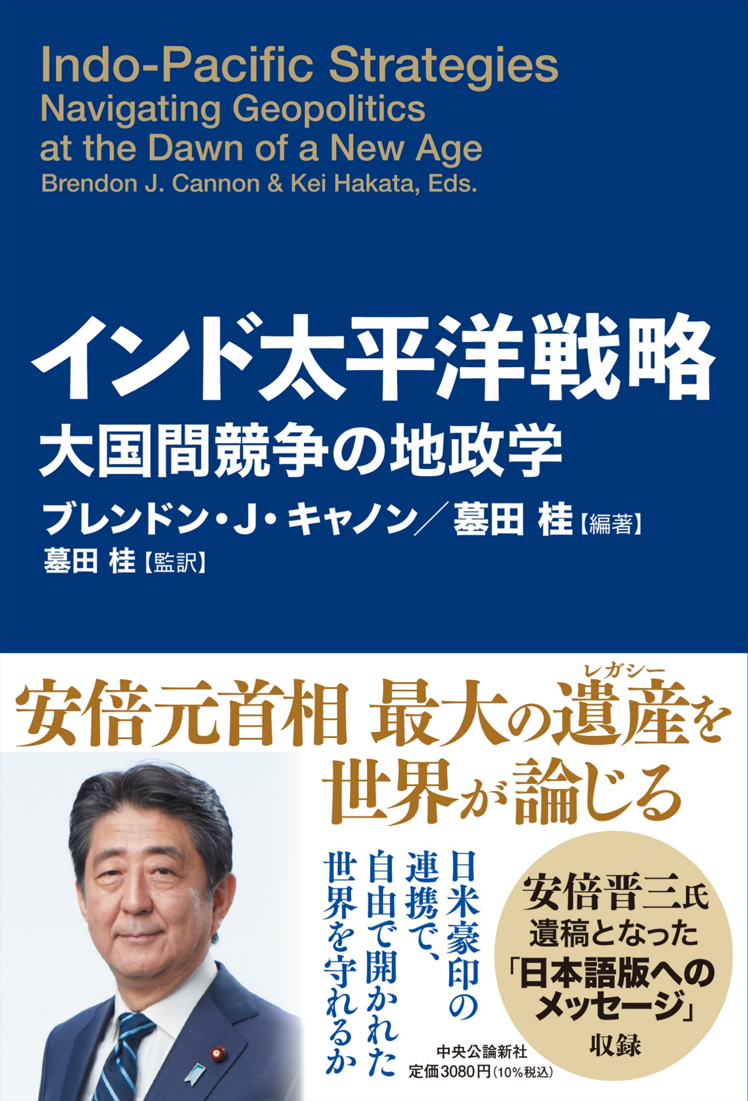
About me and the Indo-Pacific
Have published various articles and books, including Indo-Pacific Strategies (in English, Japanese and Arabic)
10 May 2022
At the late Mr. Shinzo Abe’s parliamentary office

Slide 6
What is the ‘Indo-Pacific’? What is behind it?
A ‘buzz word’ in world affairs
Accommodating the ongoing realities
In a nutshell, it is a geographised political reality
Image: caleaeuropeana.ro

Slide 7
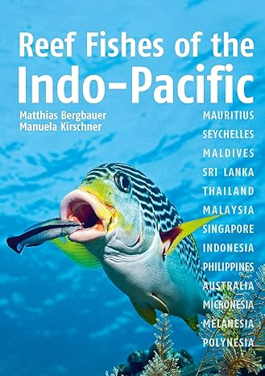
The Indo-Pacific as a social construct, like ‘Eurasia’
It is artificial, like any other geographical concepts
The Indo-Pacific concept existed well before the current prevalence
The term’s use in oceanographic studies, often referring to the region’s flora and fauna
Reevaluated in a new context
Image: Amazon

Slide 8
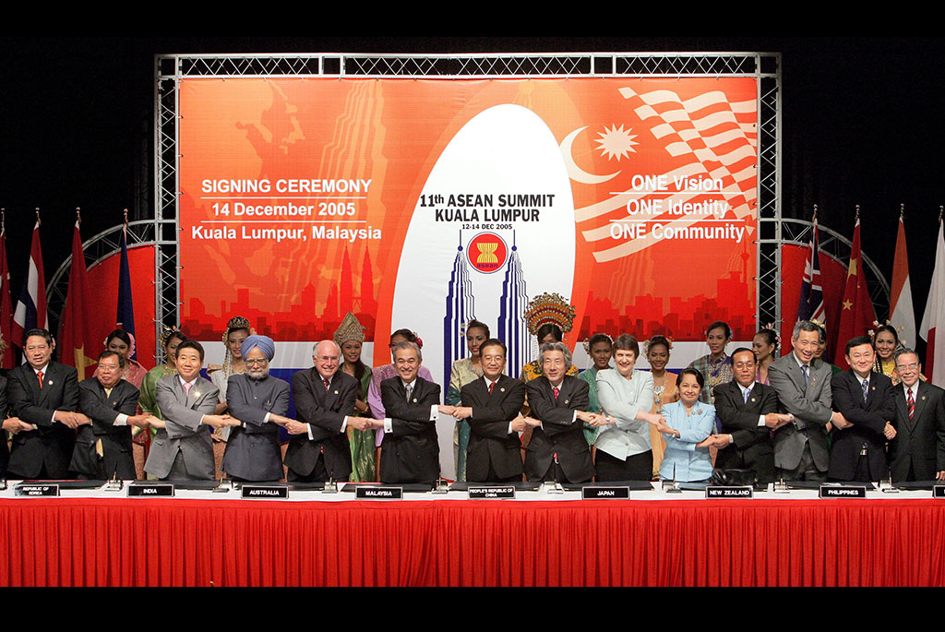
An emerging concept reflecting political realities in the 2000s
The December 2004 Indian Ocean tsunami disaster and relief coordination by Australia, India, Japan, and the US
In 2005, the first-ever East Asia Summit (EAS) was held in Kuala Lumpur, Malaysia
In reality, EAS is an Indo-Pacific platform as it includes ASEAN, China, Japan and South Korea, India, Australia, and NZ (later the US and Russia)
Signing ceremony of EAS
December 2005
Image: Australian Government

Slide 9
Japan and India contributed to the political developments in and of the Indo-Pacific
Signing of the Japan-India Strategic Partnership in December 2006
In August 2007, Japan’s PM Shinzo Abe delivered a speech titled ‘The Confluence of the Two Seas’ at the Indian Parliament
Abe, ‘unintentionally introduced a new geographical concept, “Indo-Pacific”’
Image: NHK

Slide 10
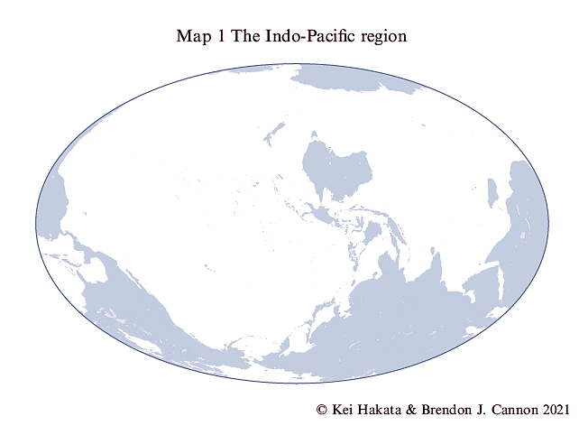
A ‘geography of strategies’
The Indo-Pacific goes beyond a mere regional name
‘Both a region and an idea’ (Rory Medcalf)
A geography of strategies in which various grand strategies are projected

Slide 11
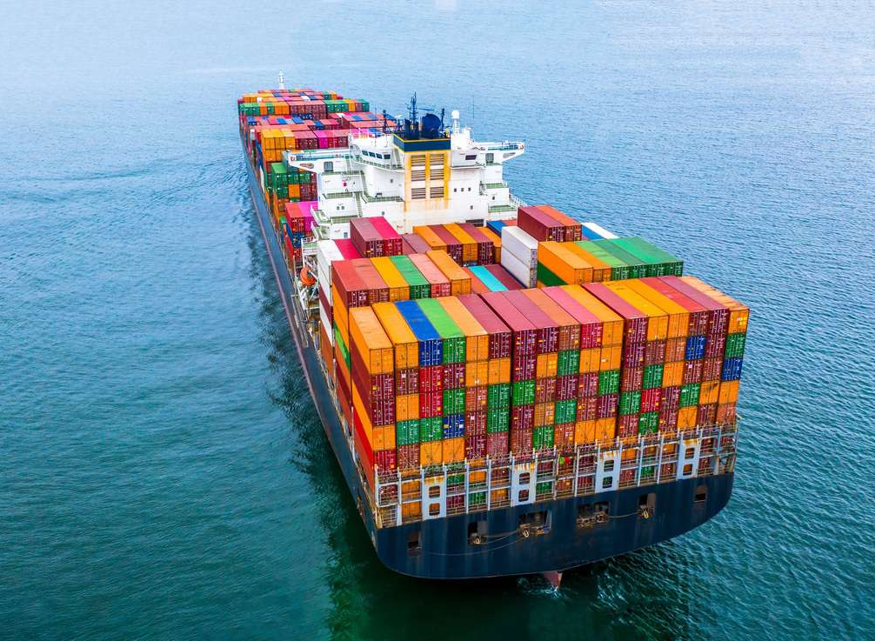
Material significance of the Indo-Pacific
Large area: Ranging from the shores of the Americas, going through maritime Asia, to the shores of Eastern Africa
The world’s most vibrant region in terms of demography and economy
Importance due to the sea lines of communication (SLOCs) in the Indian and Pacific Oceans
Image: Mairon Freight UK

Slide 12
As importantly, the ‘Indo-Pacific’ is a geostrategic concept, bearing values and norms
Values and
norms
Geostrategy

Slide 13
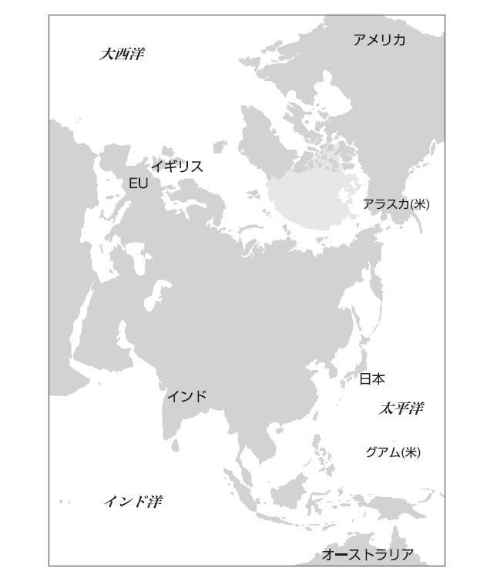
Geographical theater of the US-China competition
The rivalry makes the Indo-Pacific region particularly volatile and a ‘pivotal area’ for the 21st century
A ‘mental map’ to define the states’ related policies and strategies
A geography to counter China from the two oceans
© Kei Hakata & Brendon J. Cannon 2022

Slide 14
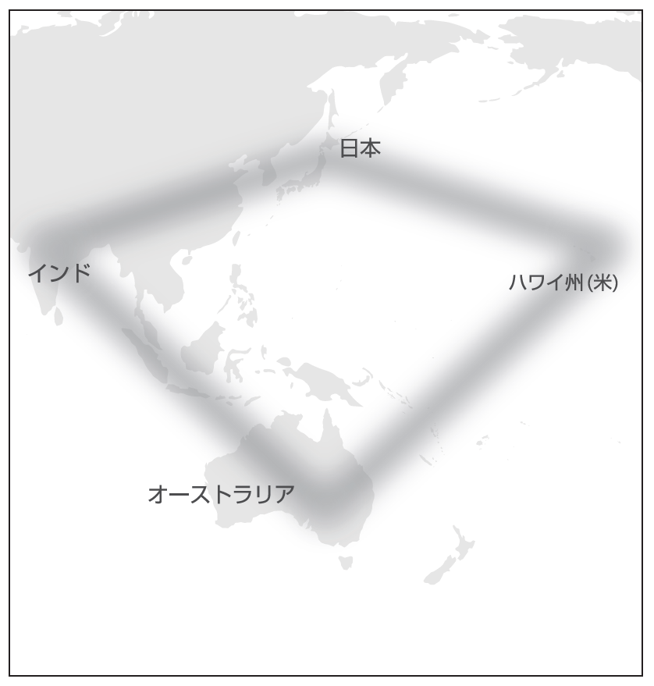
Japan’s contribution to a ‘free and open Indo-Pacific’ (FOIP)
A convergence of interests among Australia, India, Japan, and the US in the 2010s
Japan’s thought leadership
Shinzo Abe’s ‘Security Diamond’ concept, reflecting the ‘Quad’, or an informal grouping of Indo-Pacific states
Tokyo’s emphasis on the ‘Free and Open Indo-Pacific’ (FOIP) vision since 2016
Made by Kei Hakata based on :
Shinzo Abe, “Asia’s democratic security diamond,” Project Syndicate, 27 December 2012.

Slide 15
I think it would be great if we could have a meeting at the level of the heads of state or foreign ministers of the four countries, Japan, the U.S., Australia, and India (Asia-Pacific Democratic G3 plus the U.S.) to discuss from a strategic perspective how we can contribute and cooperate to share these universal values with other countries, especially in Asia, I think that would be wonderful.
Shinzo Abe, To a Beautiful Country
Published in July 2006
Image: Amazon

Slide 16
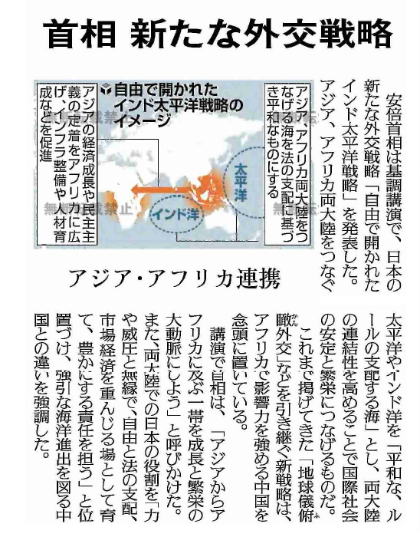
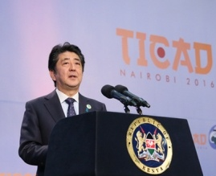
In August 2016, the FOIP ‘strategy’ was launched at the Tokyo International Conference on African Development (TICAD), held in Nairobi, Kenya
Becoming democratic countries’ flagship policies toward China
A geostrategic concept originating in Japan, which impacted the US foreign policy
[top] Article on the ‘Free and Open Indo-Pacific Strategy’
The Yomiuri Shimbun, 28 August 2016
[bottom] Then Prime Minister Abe delivers his keynote speech.
Image: MOFA of Japan

Slide 17
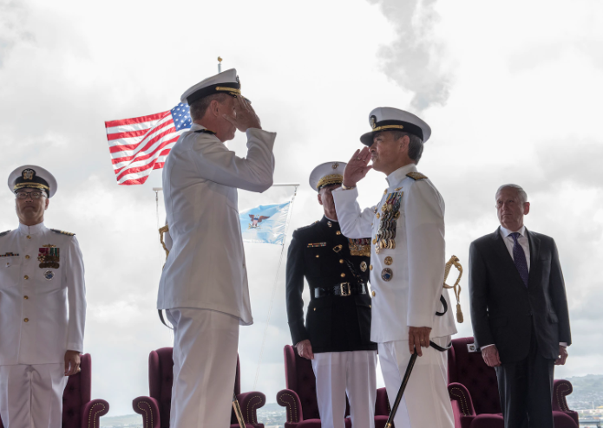
The US under President Trump has embraced Japan’s FOIP concept
Everywhere I’ve traveled on this journey, I’ve had the pleasure of sharing the good news from America. But even more, I’ve had the honor of sharing our vision for a free and open Indo-Pacific — a place where sovereign and independent nations, with diverse cultures and many different dreams, can all prosper side-by-side, and thrive in freedom and in peace.
The Former Pacific Command was renamed the ‘Indo-Pacific Command’
May 2018
Image: INDOPACOM
Speech made by US President Trump in Vietnam
10 November 2017

Slide 18
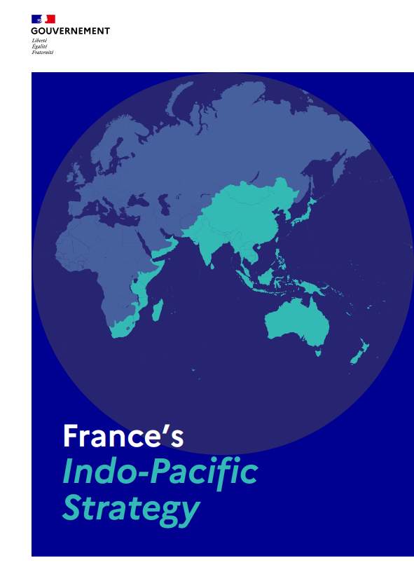
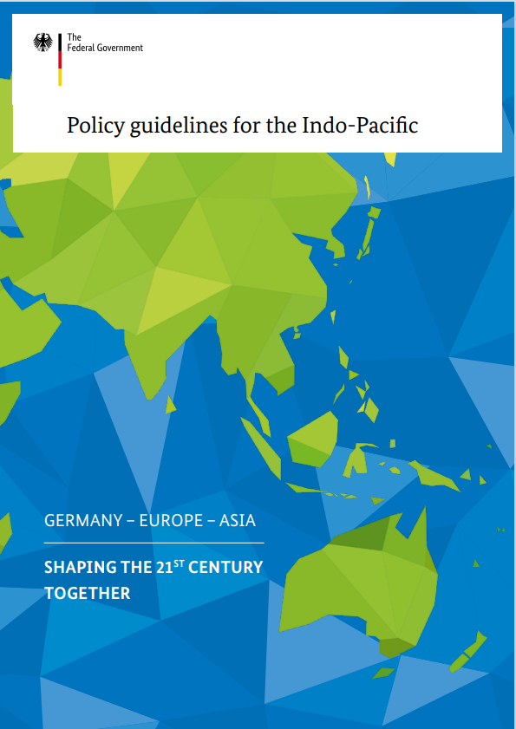
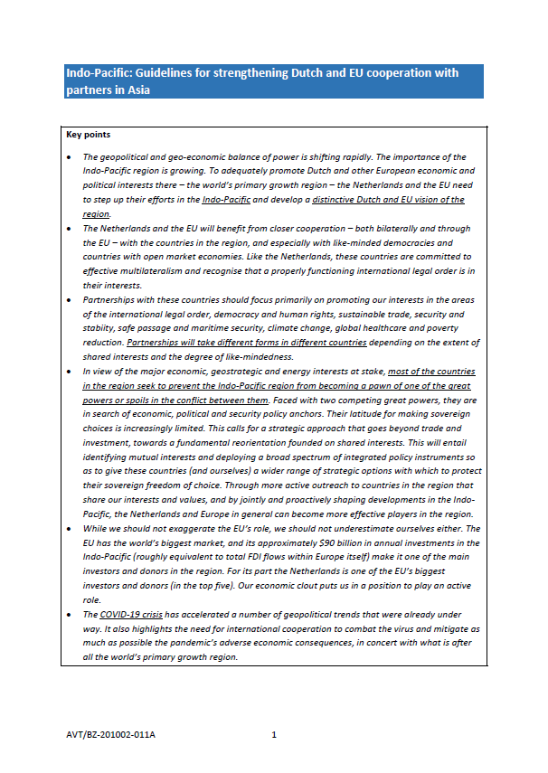
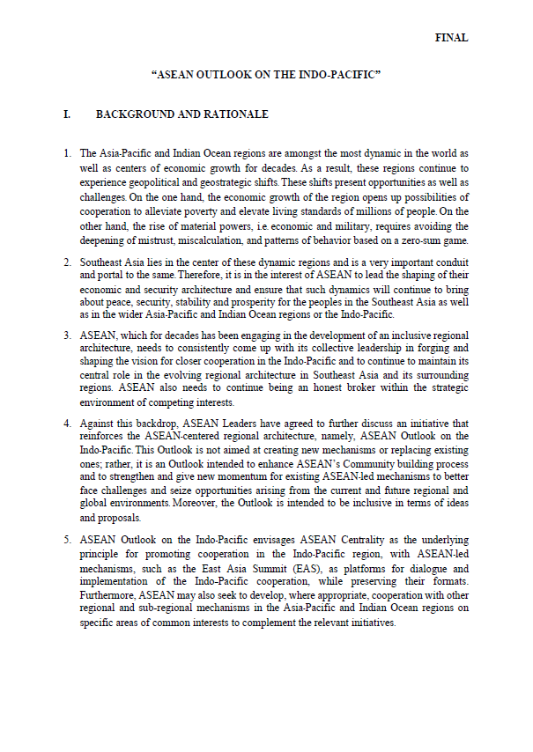
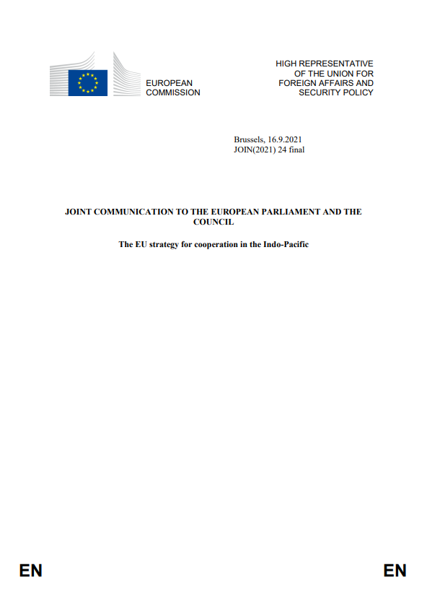
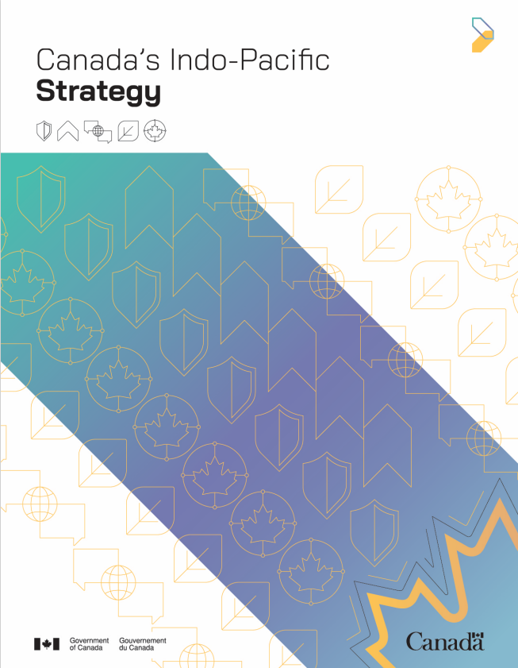
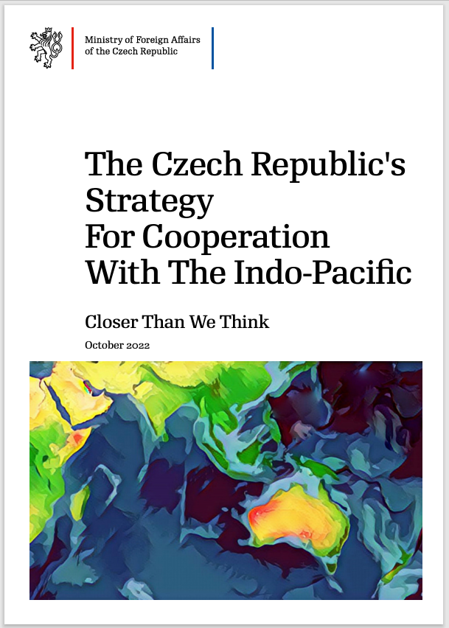
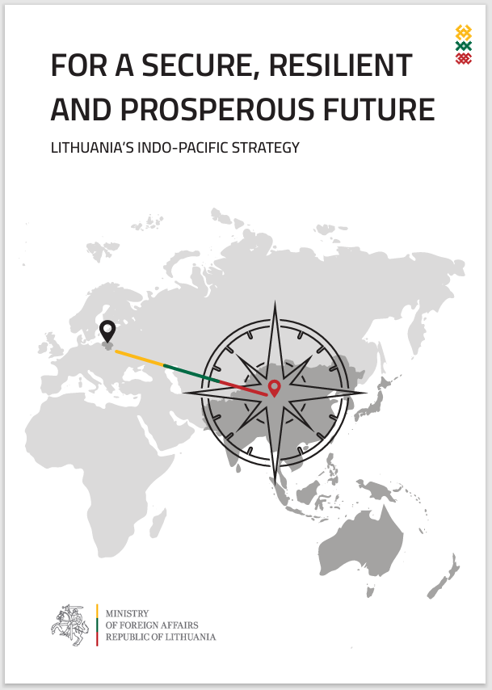
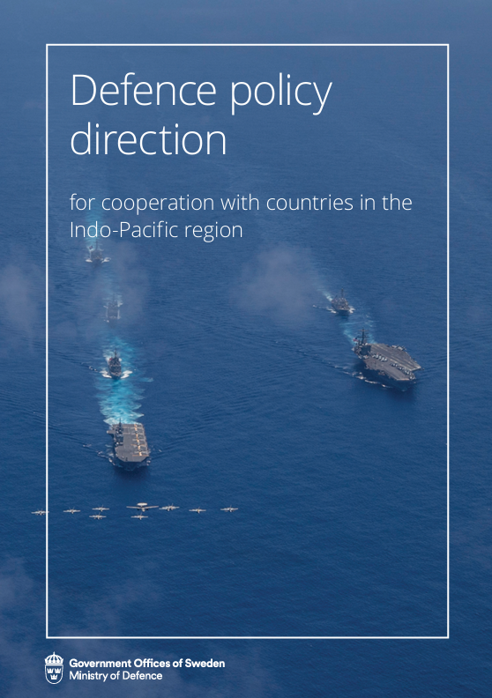
Images: various governments

Slide 19
Japan’s ‘New Plan’ for a Free and Open Indo-Pacific, launched in March 2023
Tokyo considers the international order is seriously threatened by Russian aggression against Ukraine
The ‘Global South’ changing the balance of power
Emphasis on ‘inclusiveness’ and normativity
Japan intends to play a ‘bridging role’ with the Global South
Four axes and 51 cases of cooperation
Image: PM’s Office of Japan

Slide 20
Image: MOFA

Slide 21
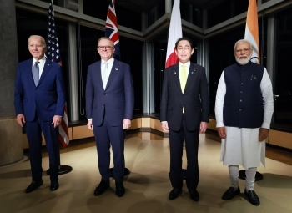
Creating alignments for a principled regionalism
The Indo-Pacific became a powerful, referential idea for keeping the rules-based international order
Has generated momentum for a principled regionalism
Emphasises fundamental principles and values and thereby tends to be selective and conditional
Quad Summit Meeting in Hiroshima, Japan, in May 2023
Image: MOFA

Slide 22
A region that is informed by the values and norms
A Pax Indo-Pacifica, or a rules-based Indo-Pacific order
Warning to Pax Sinica, or Chinese hegemony
The Indo-Pacific idea demonstrates the strong will to deny acts of coercion and predation, continuously shown by China
Image: New York Post

Slide 23
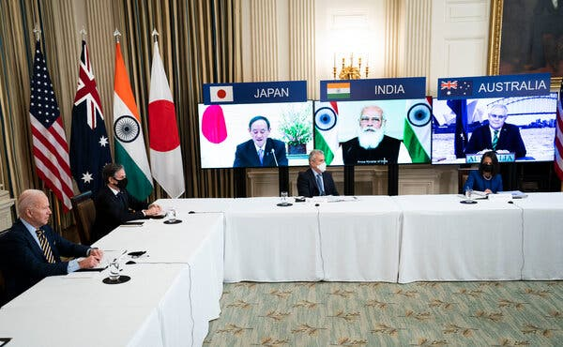
Indo-Pacific strategies consisting of
Strengthening of cooperation between like-minded states such as Japan, the U.S., Australia, and India
Narrative formation
Connectivity projects and technical cooperation
Promotion of economic partnerships and agreements
Maintenance of maritime order and maritime security
Online summit meeting of the Quad
March 2021
Image: New York Times

Slide 24
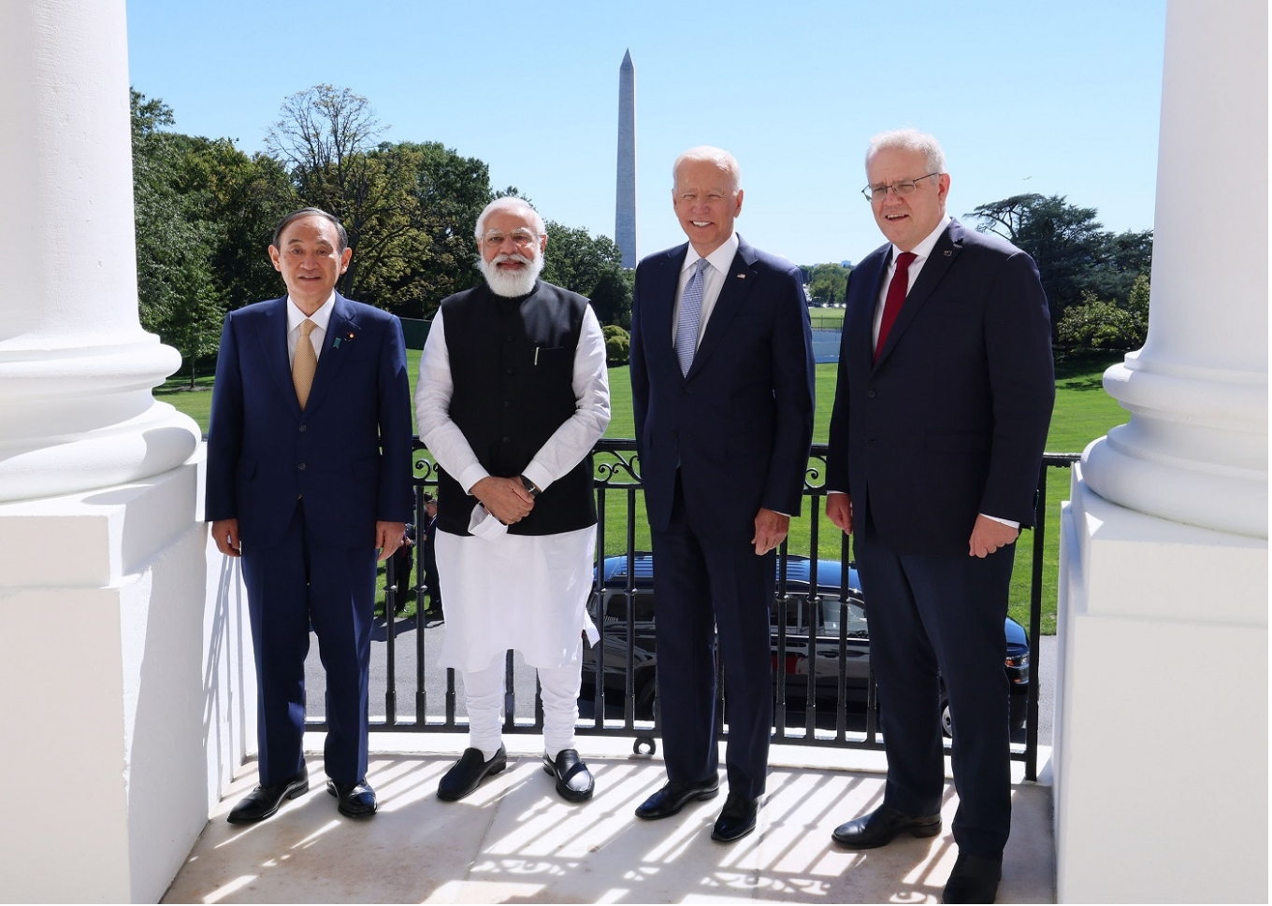
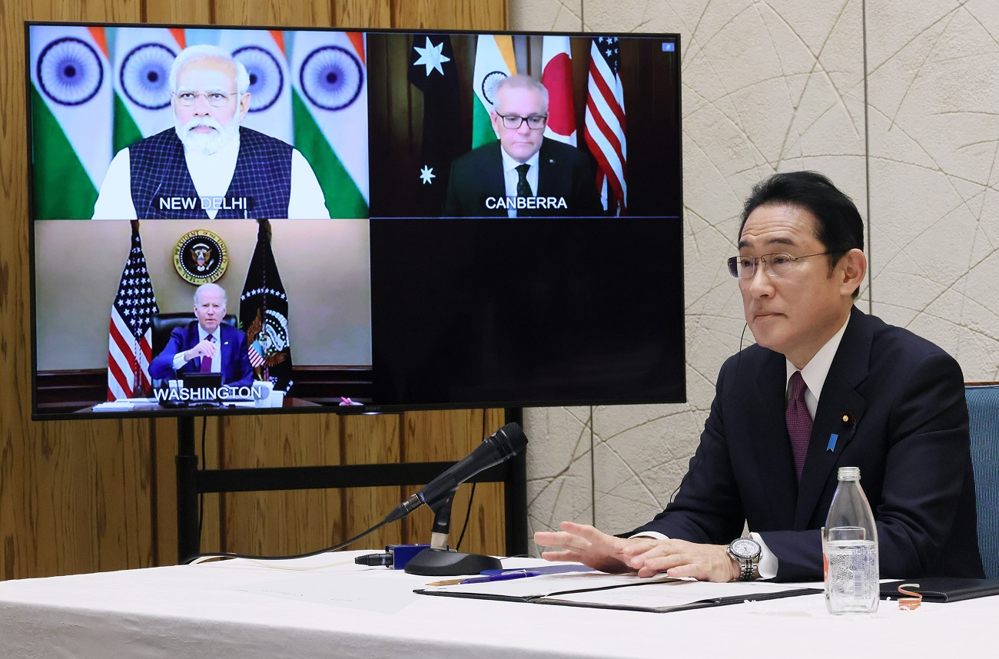
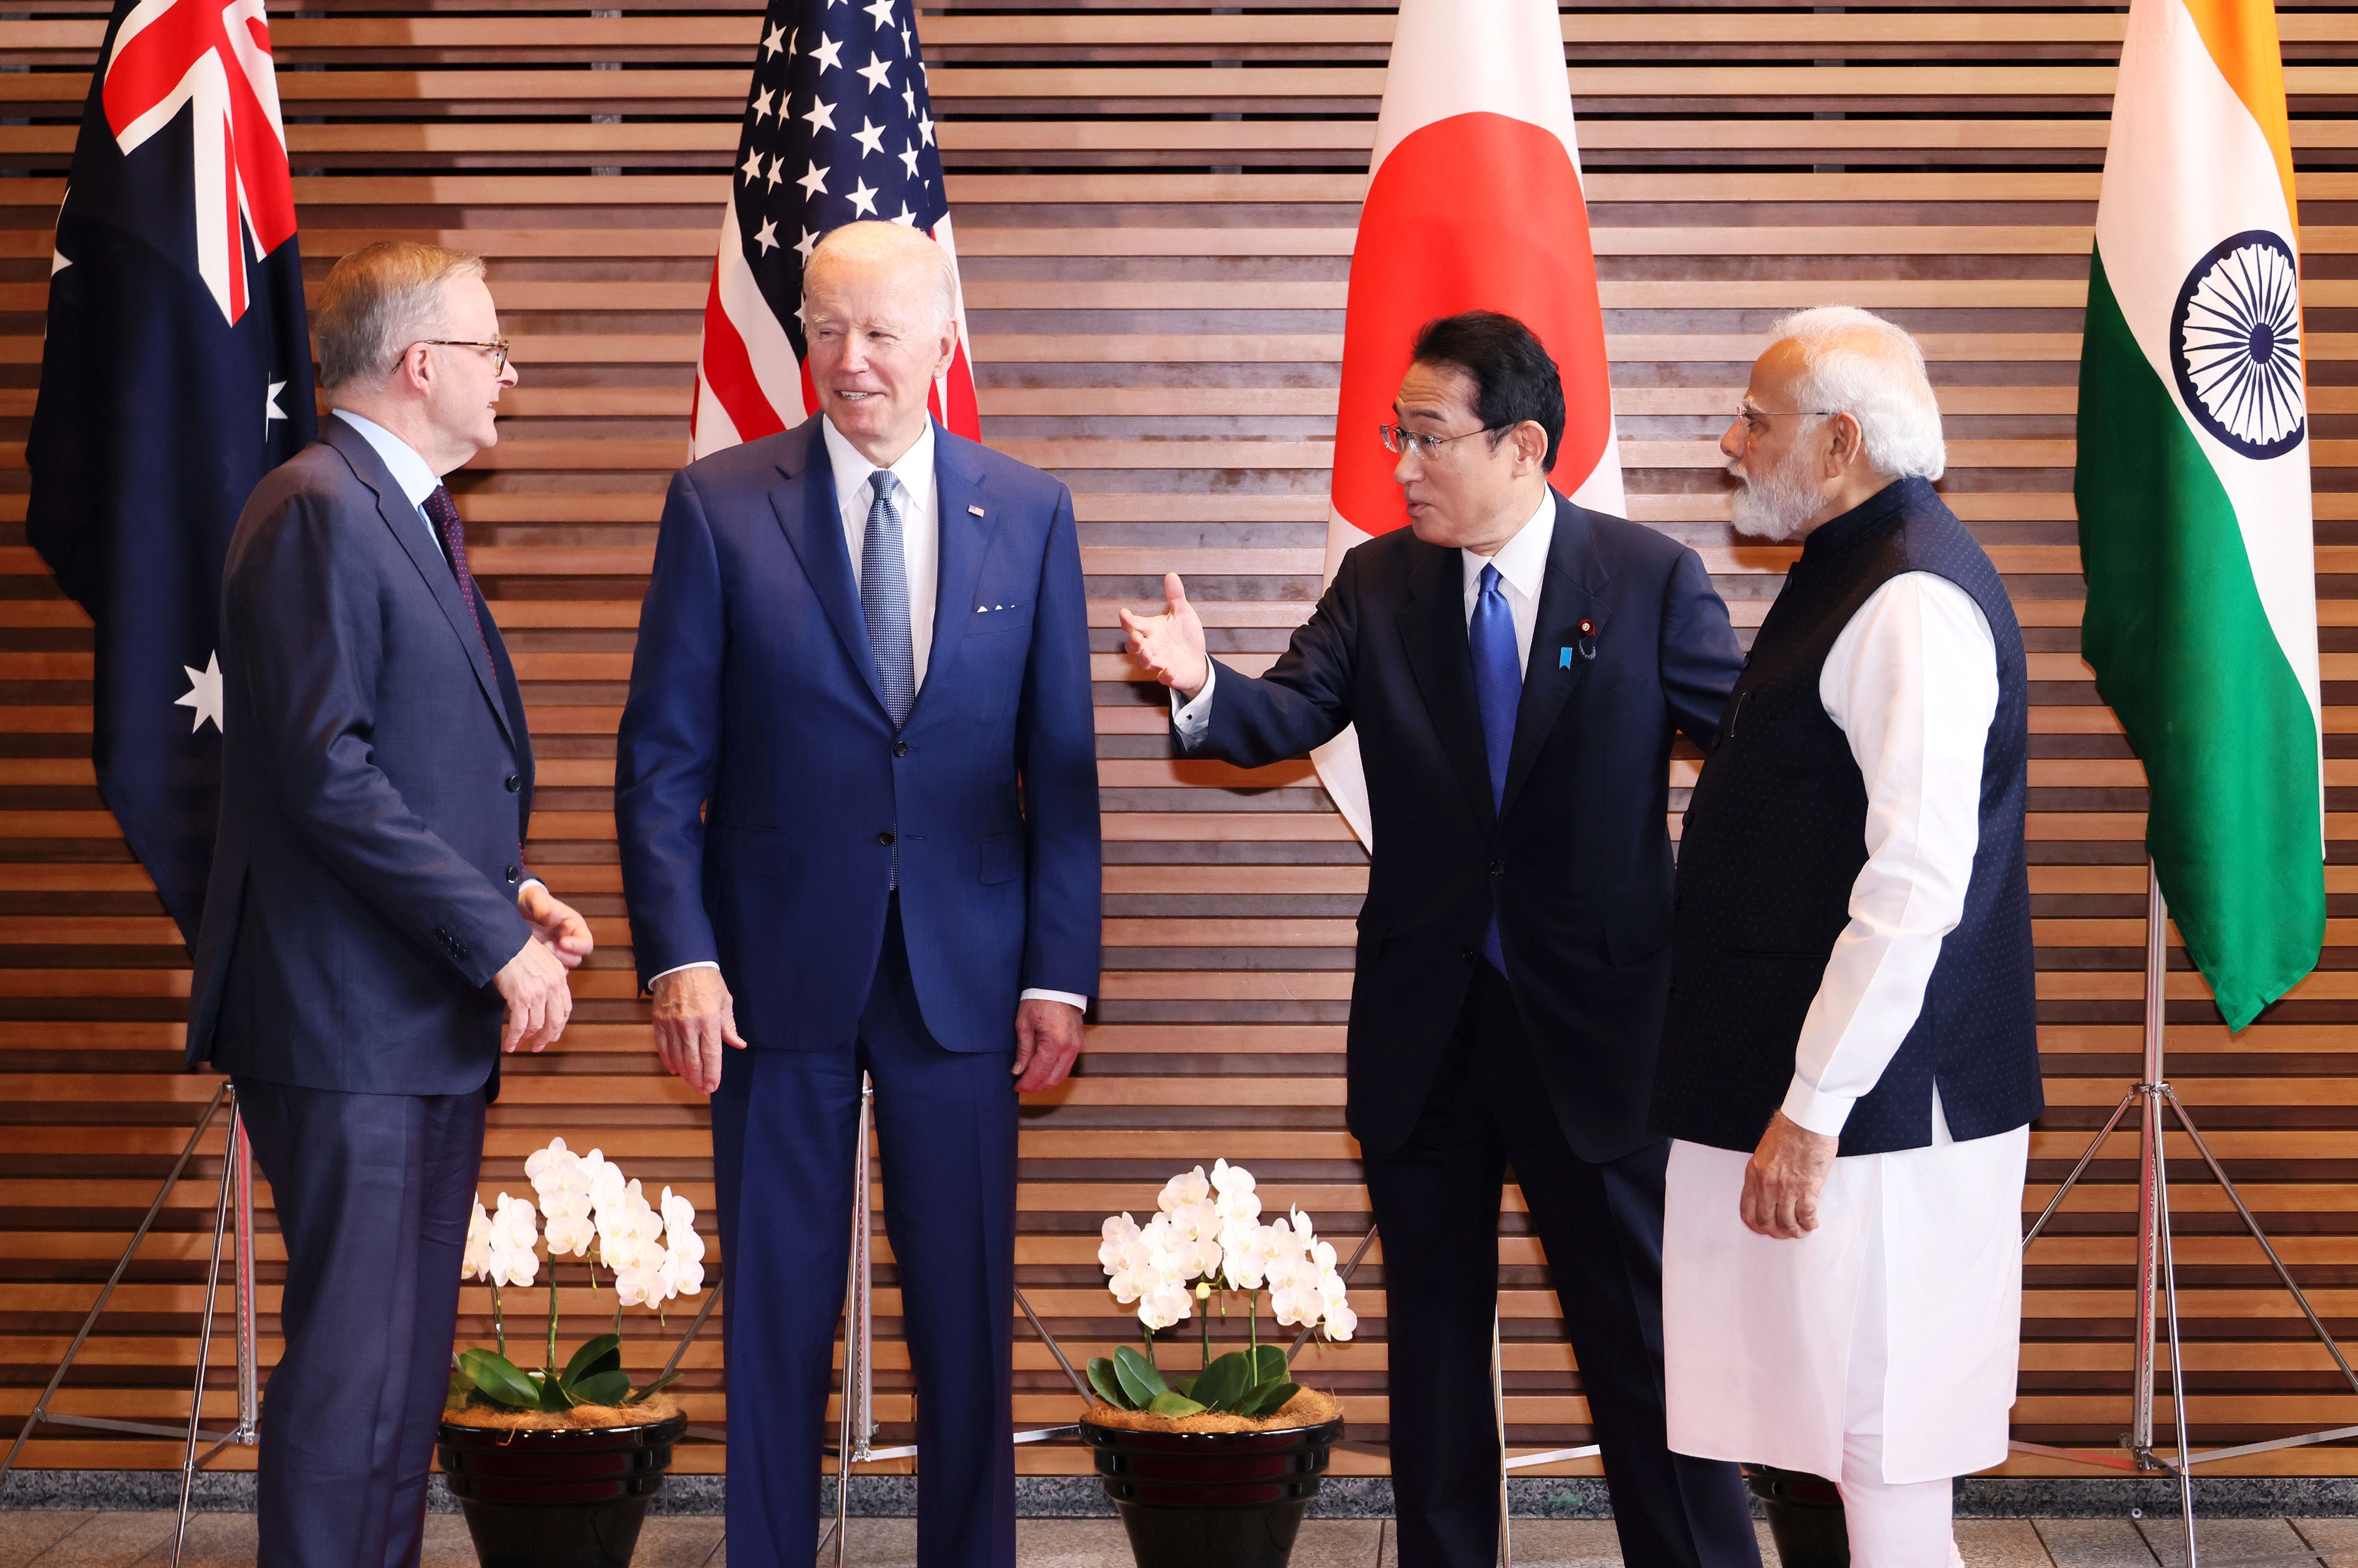
1) Strengthening of cooperation between like-minded states
Quadrilateral (Quad) alignment of the like-minded partners
Regular meetings of the foreign ministers (since September 2019) and leaders (since March 2021) of the Quad
Declarations and wide-reaching programs by the Quad
A powerful (and perhaps only) engine of Indo-Pacific cooperation
Washington, D.C. Sept. 2021
Image: PM’s Office
Online, March 2022
Image: PM’s Office
Tokyo, May 2022
Image: PM’s Office

Slide 25
2) Narrative formation based on universal norms
Indo-Pacific states’ narratives based on universal norms and aimed at a status quo
vs.
China’s revisionist narratives (as an alternative)
China champions the development of a community with a shared future for mankind, and has encouraged the evolution of the global governance system. With this we have seen a further rise in China’s international influence, ability to inspire, and power to shape; and China has made great new contributions to global peace and development.
Xi Jinping’s report at 19th National Congress
of China’s Communist Party in October 2017

Slide 26
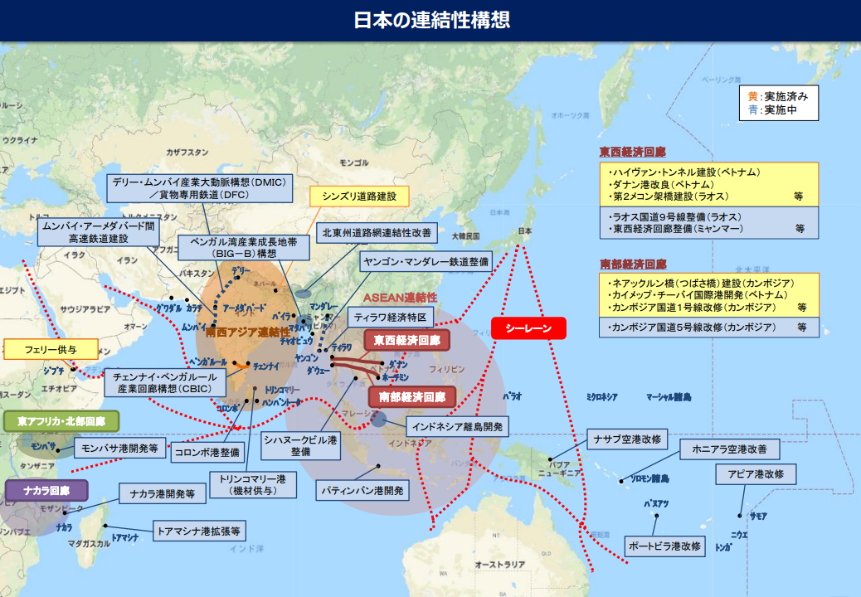
3) Connectivity projects and technical cooperation
(Japan’s connectivity vision)
Image: MOFA

Slide 27
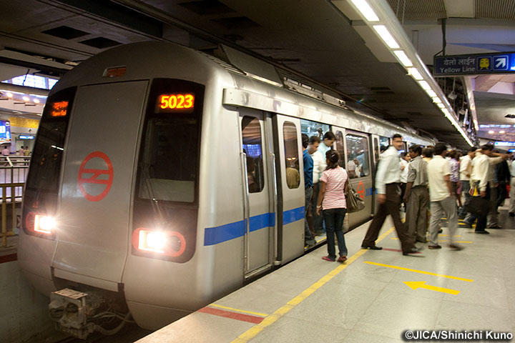
Nadzab Tomodachi International Airport
in Papua New Guinea
Image: JICA
Providing quality infrastructure as part of Indo-Pacific cooperation
Alternative to China’s Belt and Road Initiative (BRI)
New Delhi Rapid Transit System Construction Project
Image: JICA

Slide 28
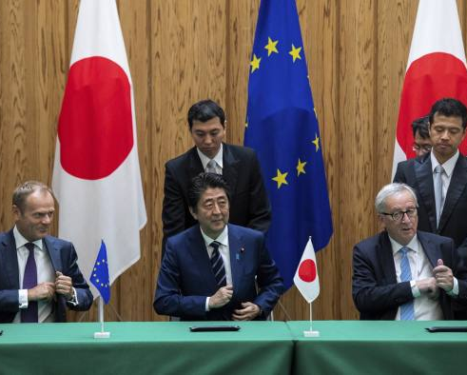
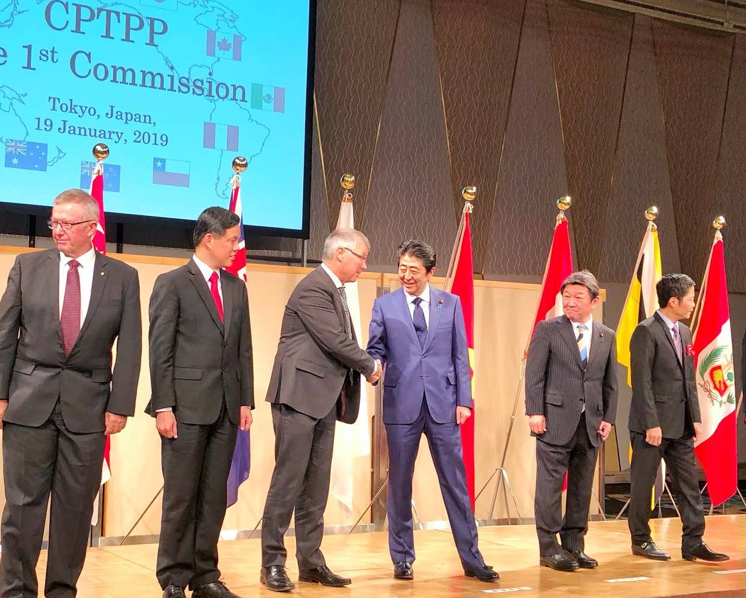
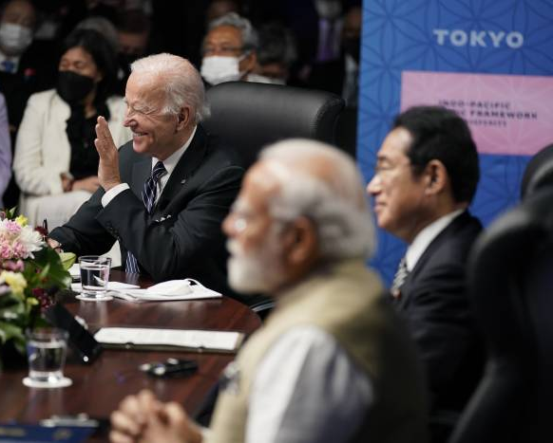
4) Promotion of economic partnerships and agreements
EU-Japan Economic Partnership Agreement (EPA)
Comprehensive and Progressive Agreement for Trans-Pacific Partnership (CPTPP)
Indo-Pacific Economic Framework (IPEF)
Signing ceremony
July 2018
Image: MOFA
First Commission Meeting,
January 2019
Image: PM’s Office
Launching ceremony
May 2022
Image: Wall Street Journal

Slide 29
4) Maintaining maritime order and security
Image: Ministry of Defense of Japan

Slide 30
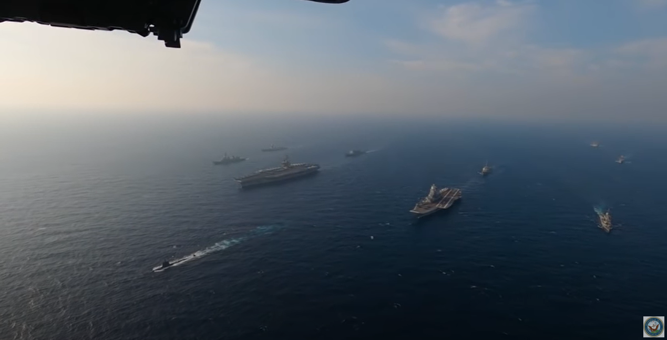
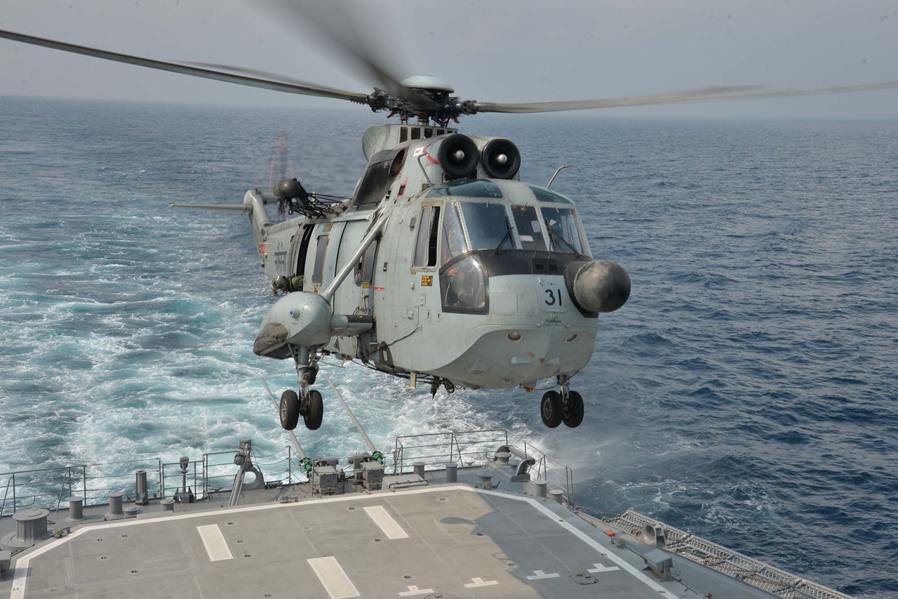
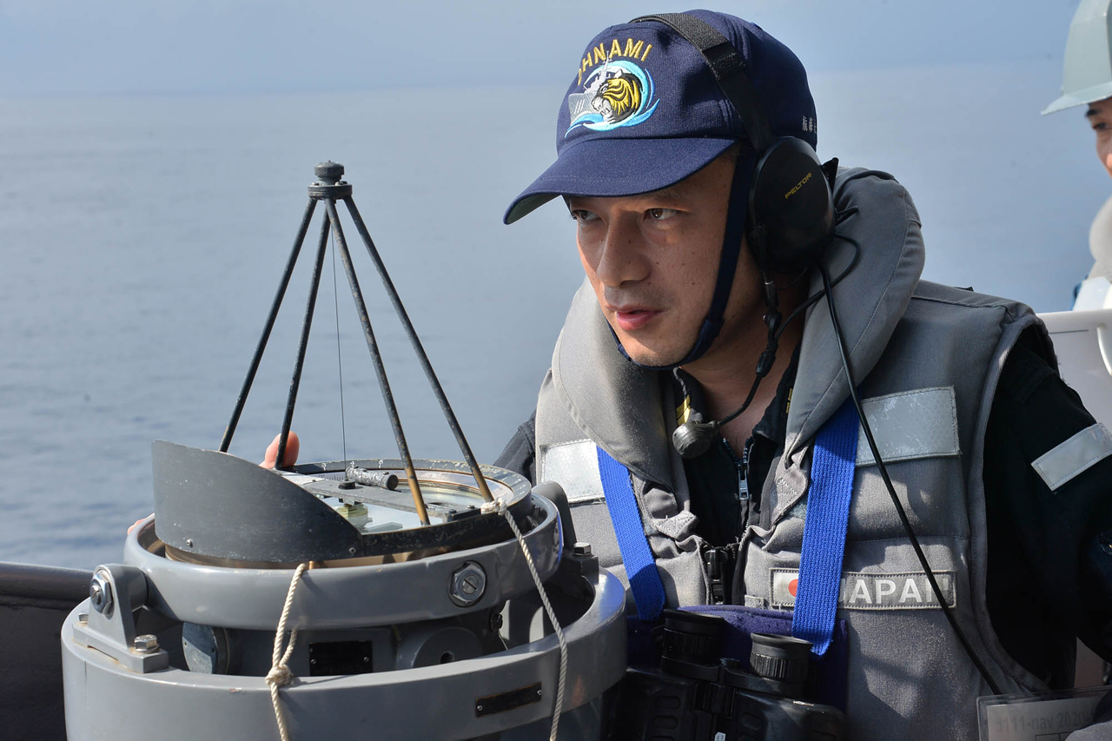
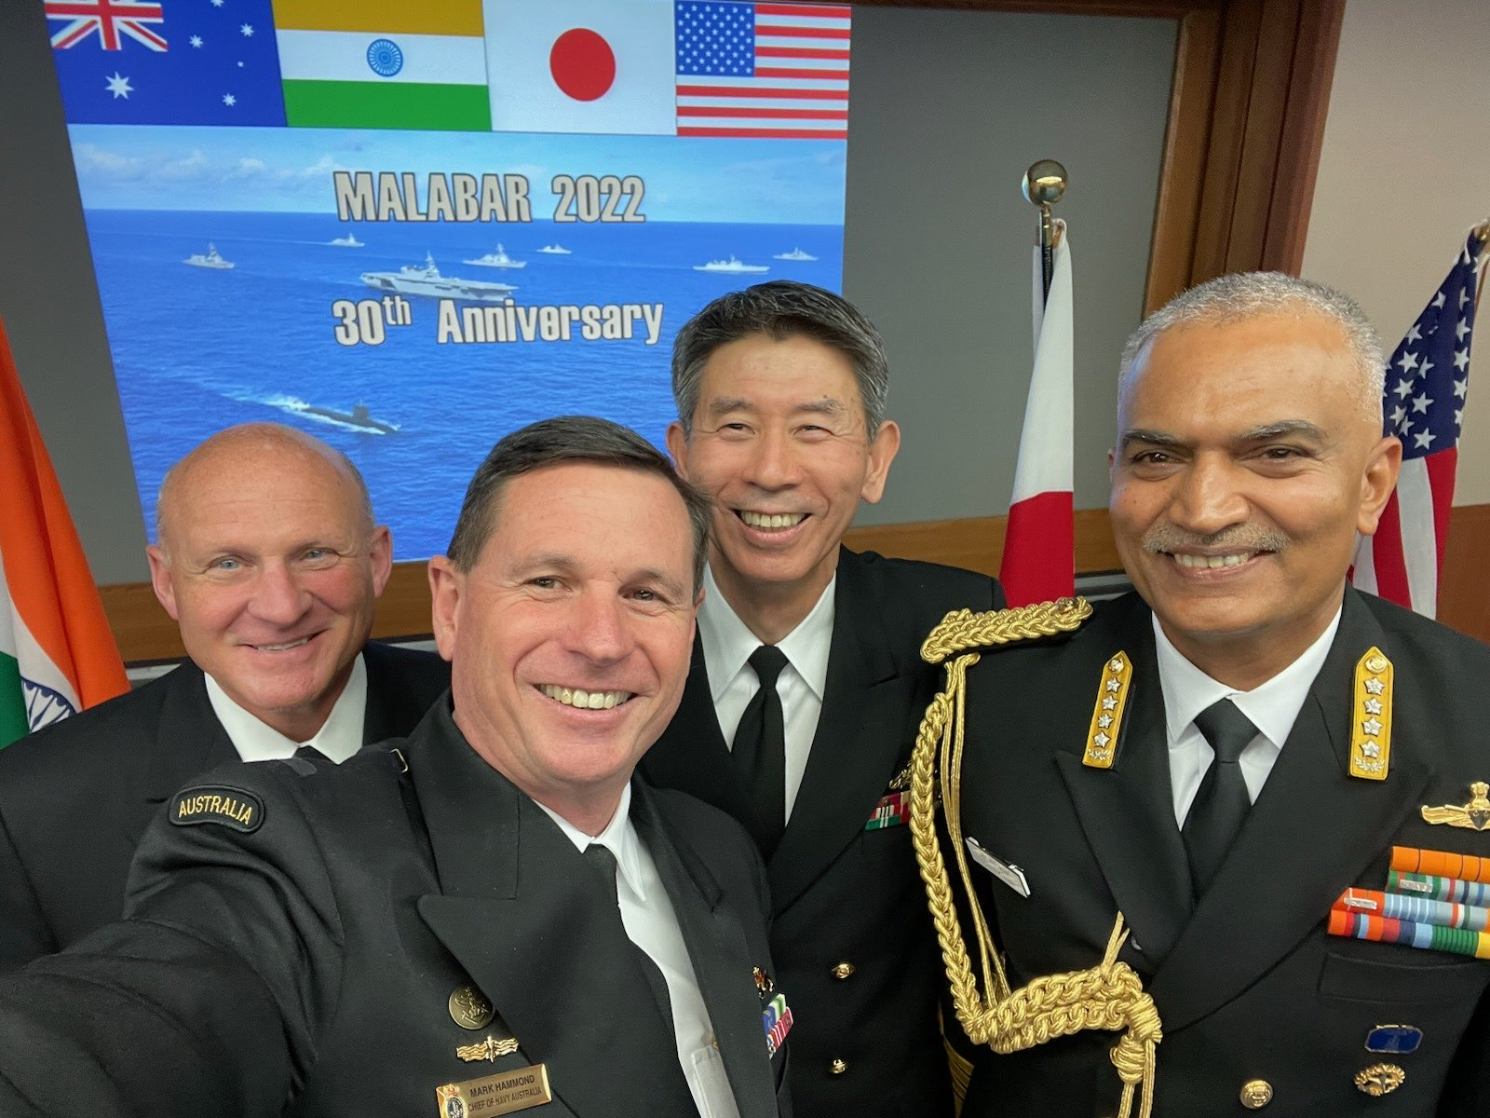
Images: JMSDF and US Navy
Naval drills/exercises
‘Malabar’ joint exercise between Australia, India, Japan, and the U.S.
A collective effort to project maritime power to balance China’s expansionism
Image: Chief of Navy Australia

Slide 31
Strategic successes and challenges
Indo-Pacific initiatives generated a dynamic necessary to keep a balance of power vis-à-vis China
However, the Indo-Pacific is only one part of the world
Various regions and spaces need to be considered, necessitating an ‘Indo-Pacific Plus’ approach
To keep the global power balance vis-à-vis China, the Quad states must go beyond the narrowly defined geography
Tokyo’s increasing reference to a ‘free and open international order based on the rule of law’

Slide 32
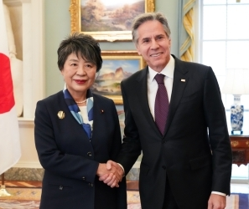
Image: MOFA
‘The two ministers concurred on coordinating to further strengthen the Japan-U.S. Alliance, a global partnership, to uphold and strengthen the free and open international order based on the rule of law and to ensure the world where human dignity is secured’.
Japan-U.S. Foreign Ministers’ Meeting
MOFA, 12 January 2024

Slide 33
The concept of a ‘Free and Open International Order’ is broader than that of a ‘Free and Open Indo-Pacific’
Note: The map was designed by the lecturer and
is based on the conceptual explanation by MOFA

Slide 34
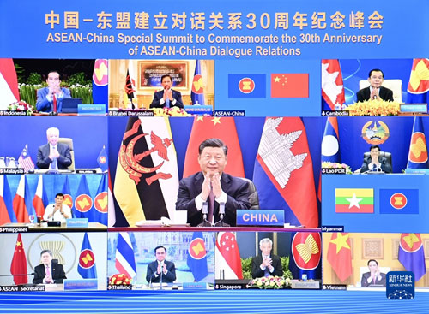
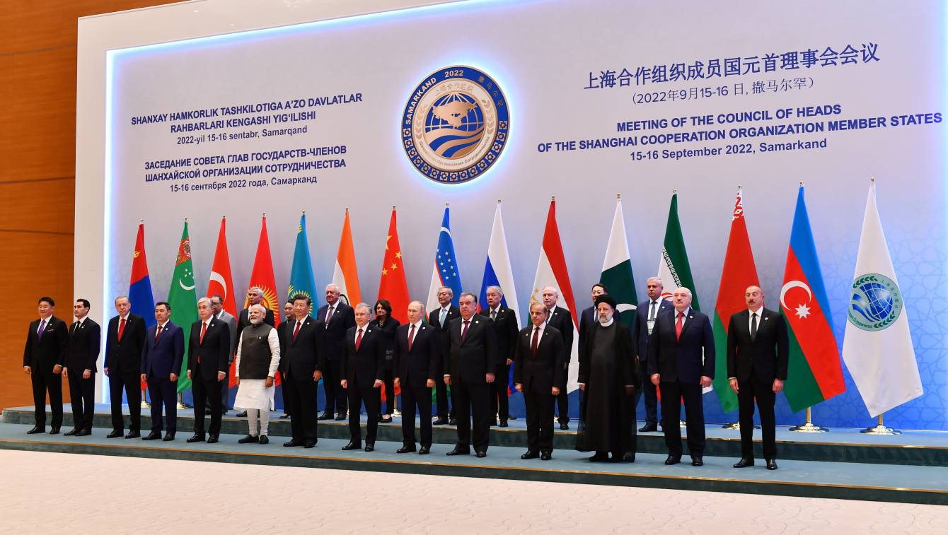
Image: Chinese Ministry of Foreign Affairs
The ‘fence sitters’ and ‘hedging middles’ in the Global South seriously challenge the efforts of coalition building
Difficulties in building a coalition to counter China
How to deal with Taiwan
Summit meeting of Shanghai Cooperation Organization (SCO)
in Uzbekistan, September 2022,
Image: Azerbaijan Presidential Office

Slide 35
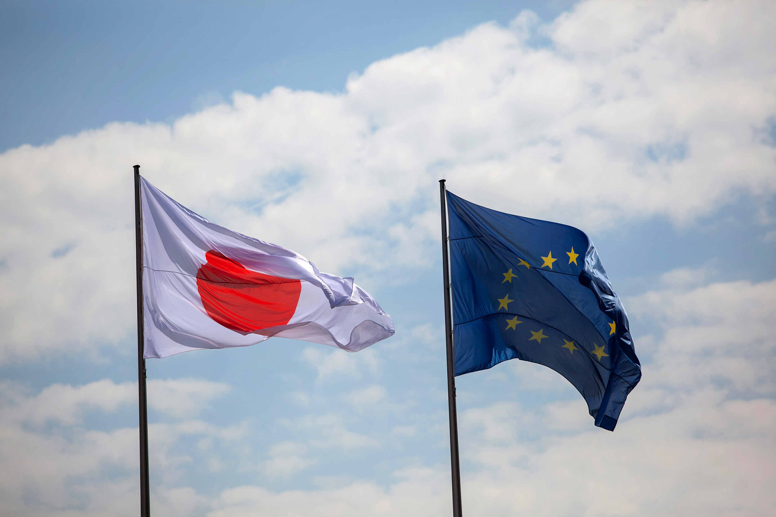
Japan’s engagement with European countries and institutions
1) Japan and the EU
Distant players (e.g., Japan’s trade surplus and frictions with European states in the 1980s)
The 1991 Hague Declaration between Japan and European Community
Deepening of relations in the 1990s
The 2001 Action Plan for EU-Japan Cooperation
Image: Bloomberg

Slide 36
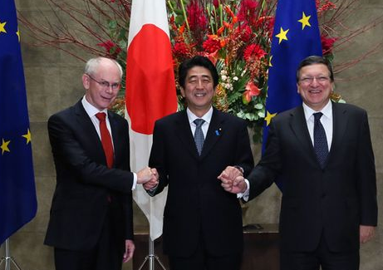
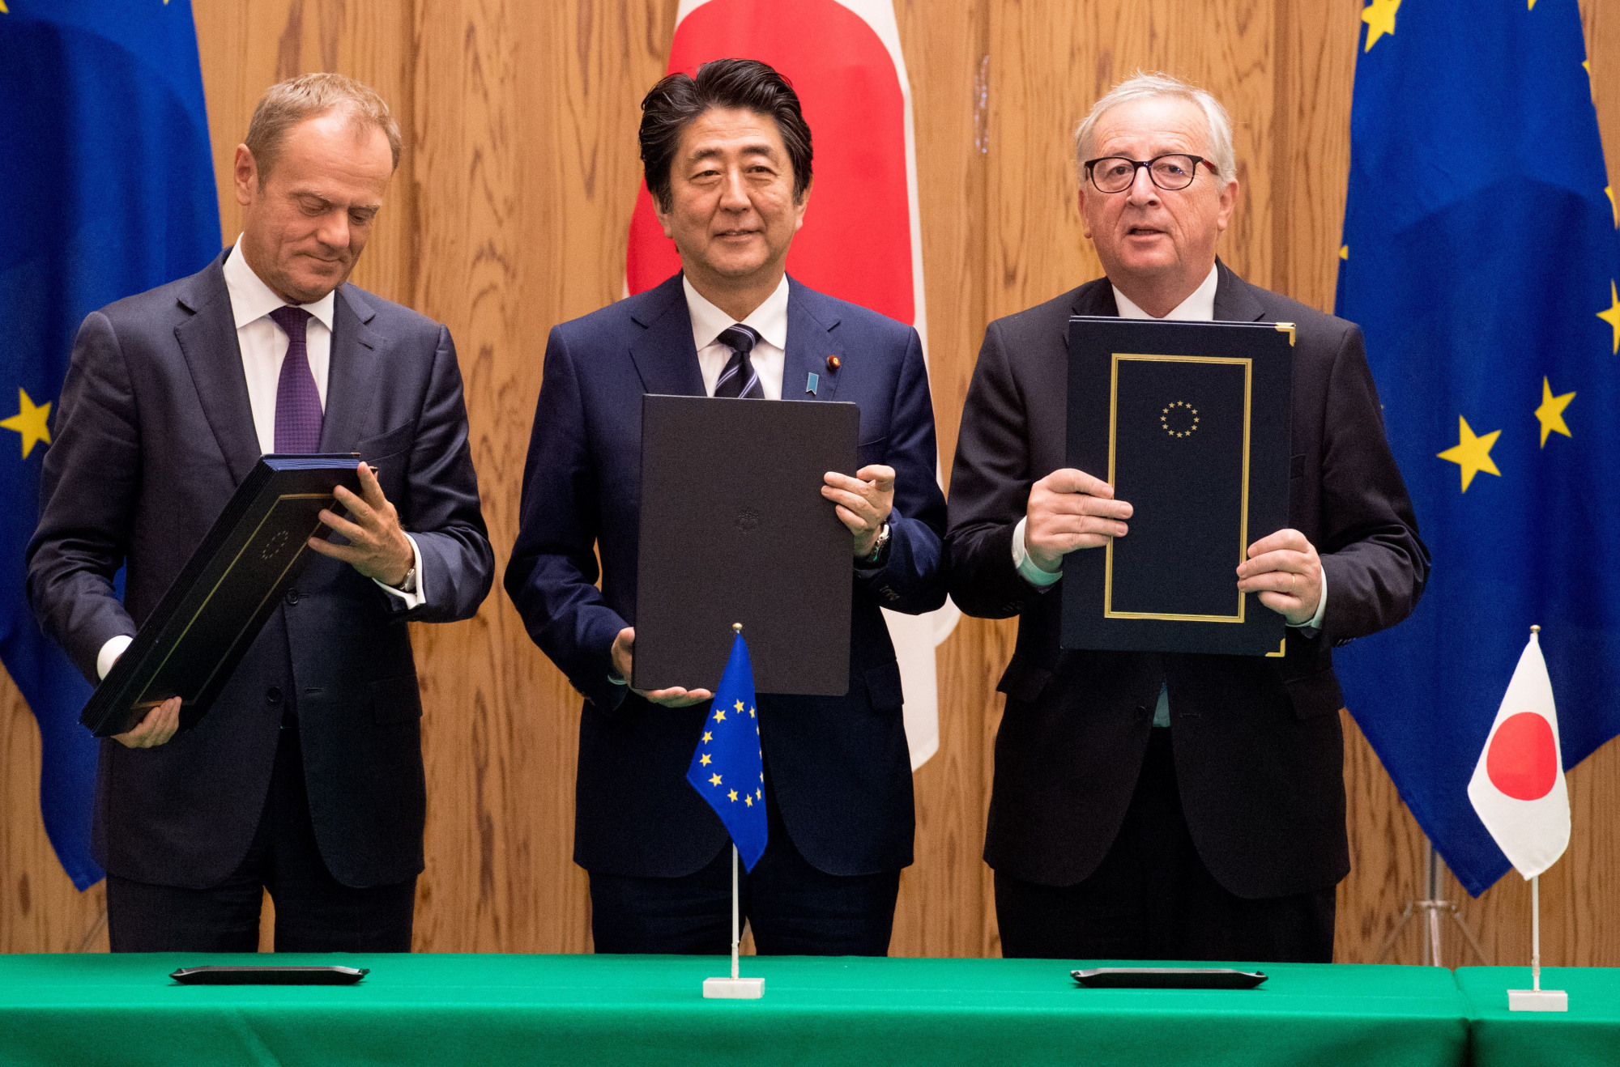
Image: PM’s Office
Japan-EU Summit meeting in November 2013 and its Joint Press Statement, announcing ‘A new stage of Japan-EU relations’
Signing of the Strategic Partnership Agreement (SPA) and Economic Partnership Agreement (EPA) in July 2018
Convergence of interests between Japan and EU in the face of US President Donald Trump
Image: Japan Times

Slide 37
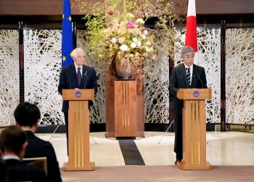
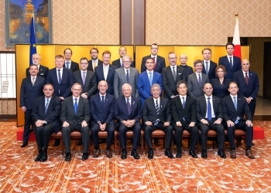
Japan-EU Security and Defence Partnership, concluded in November 2024
This document concretizes the Japan-EU Strategic Partnership Agreement (SPA)
EU’s increasing interest in the Comprehensive and Progressive Agreement for Trans-Pacific Partnership (CPTPP)
Images: MOFA

Slide 38
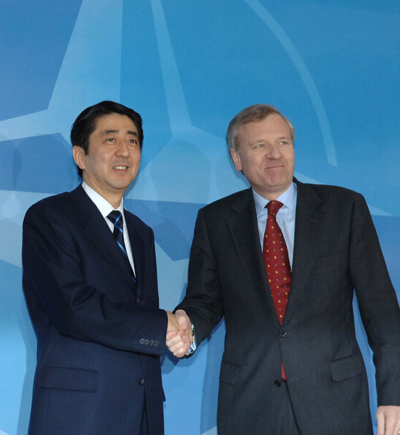
2) Japan and NATO
Apparently little linkage during the Cold War
PM Abe’s visit in January 2007
Together with like-minded countries, Japan shall support the free and prosperous world built (…) we agreed that beyond the framework of bilateral relations, Japan and Europe need to address together the challenges facing the international community. (…) we recognize together that Japan and Europe are important partners in that respect.
Press Conference by Prime Minister Shinzo Abe
Following His Visit to Europe
Image: NATO

Slide 39
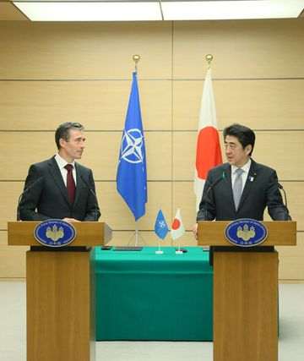
Image: PM’s Office
Joint Political Declaration between Japan and NATO in April 2013
PM Abe’s visit in May 2014
Signing of the Individual Partnership and Cooperation Programme (IPCP)
A Japan that takes a panoramic perspective of the world map. A Japan that puts the policy of “Proactive Contribution to Peace” into practice to contribute to world peace and prosperity. For this kind of Japan, NATO, which shares our fundamental values, is indeed our “natural partner.”
Japan and NATO As “Natural Partners”
- Speech by Prime Minister Abe
Image: NATO

Slide 40
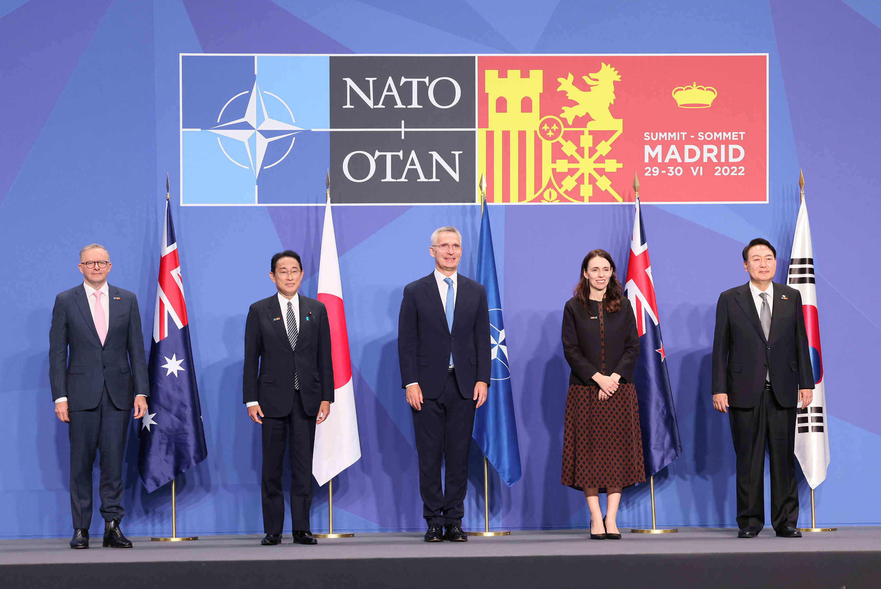
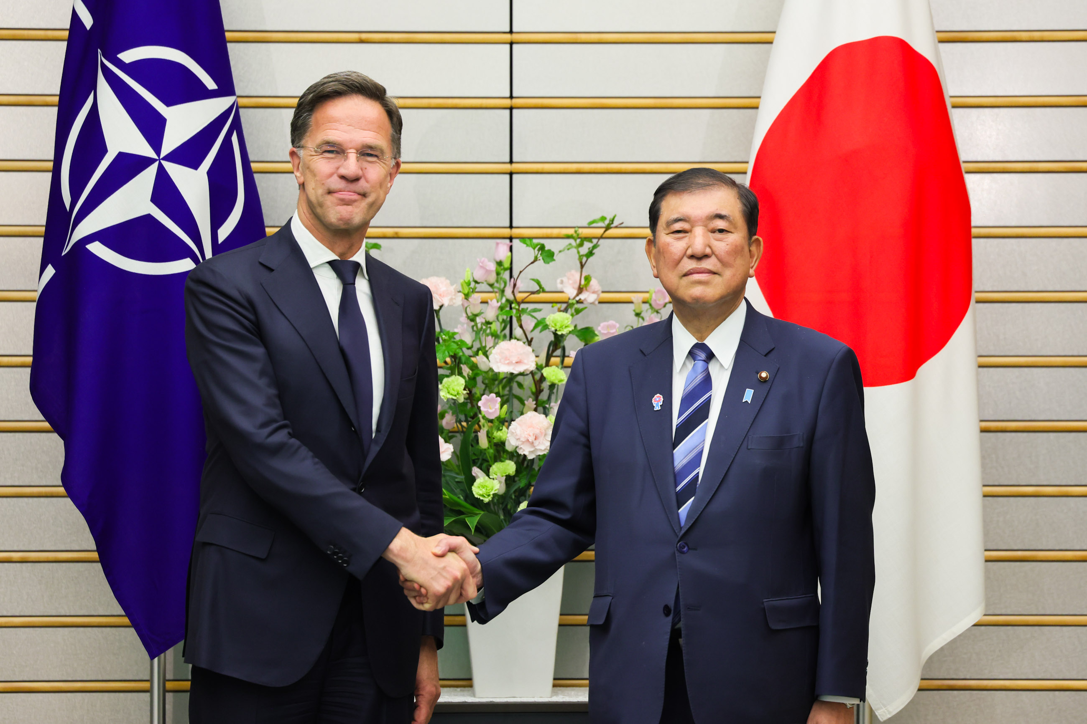
Japan’s attendance at the NATO Summit since June 2022
NATO and Indo-Pacific
The Indo-Pacific’s 4 states (IP4): Japan, South Korea, Australia, New Zealand
Convergence of strategic interests
France’s veto for NATO’s office in Tokyo
Embassies of Norway and Romania as NATO’s contact points in Tokyo
Images: PM’s Office

Slide 41
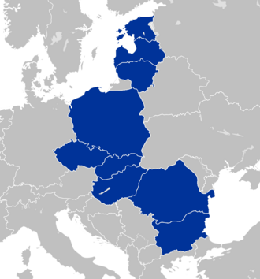
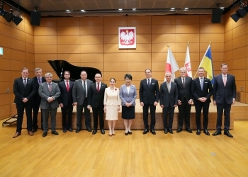
Engaging with Bucharest Nine/Format (Format Bucuresti)?
Participated by nine countries: Bulgaria, Czech Republic, Estonia, Hungary, Latvia, Lithuania, Poland, Romania, Slovakia
Image: Wikipedia
Luncheon meeting between Japan’s FM and Ambassadors from Bucharest Nine
Polish Embassy in Tokyo, September 2023
Image: MOFA

Slide 42
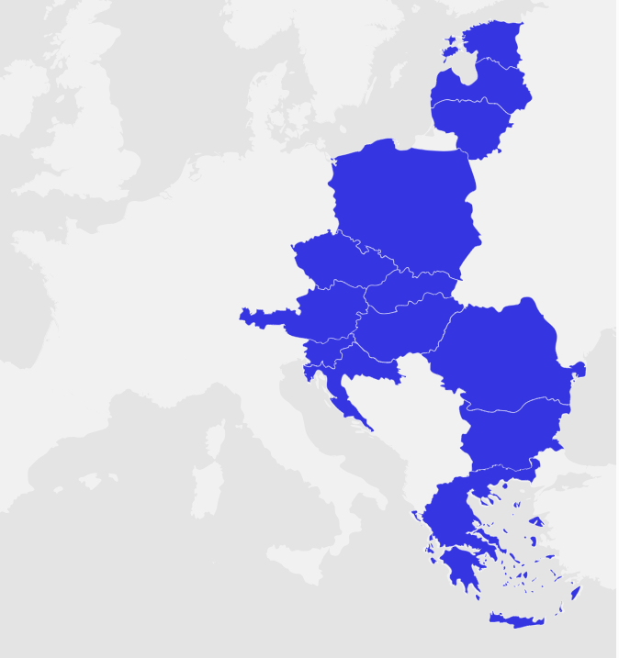
3) Japan and 3SI
Three Seas Initiative (3SI), embracing the Baltic, Adratic and Black Seas (now also the Aegean and Mediterranean Seas)
A cooperation framework led by Poland and Croatia
Participated by 13 countries (Estonia, Latvia, Lithuania, Poland, the Czech Republic, Slovakia, Hungary, Slovenia, Austria, Croatia, Romania, Greece, and Bulgaria)
Image: 3SI

Slide 43
Japan as a ‘strategic partner’ of the Three Seas Initiative (decided in April 2024)
PM Shigeru Ishiba’s message for the 10th 3SI Summit, April 2025
Images: 3SI

Slide 44
The 3SI is an important initiative that will contribute to a strong, prosperous and united Europe by bolstering the connectivity of Central and Eastern Europe and the Baltic States. As the security of Europe and the Indo-Pacific are increasingly recognized as inseparable, Japan strongly supports this initiative. I would therefore like to express my respect for Romania’s leadership in hosting this Summit. The importance of promoting infrastructure development based on 3SI is stated in a Strategic Partnership between Japan and Romania that President Iohannis and I announced in March of this year. In Romania, Japan’s high quality technology is helping to strengthen connectivity, the best example is Braila Bridge, a large suspension bridge over the Danube River. (…)
Video Message by Prime Minister KISHIDA Fumio
at the Three Seas Summit, Bucharest, September 2023

Slide 45
4) Strategic partnership with selected, like-minded partners
Producing the next generation fighters with UK and Italy
Establishment of GIGO (Global Combat Air Programme International Government Organisation)
Image: Ministry of Defense
Image: Japan Times

Slide 46
Image: PM’s Office
Reciprocal Access Agreement (RAA) with UK (concluded in January 2023) and with France (under negotiations)
Acquisition and cross-servicing agreement (ACSA) with Germany (concluded in January 2024)
Memorandum on Defense Cooperation and Exchanges with Poland (signed in February 2022)
Image: German Foreign Office

Slide 47
[Top] Image: MOFA
Japan’s approach to Finland and Sweden and its Nordic Diplomacy policy (announced in Jan. 2024)
[Left] Image: MOFA
[Right] Image: Yoko Kamikawa on X

Slide 48
Converging strategic interests between Tokyo and Bucharest
Establishment of the Strategic Partnership between Japan and Romania, concluded in March 2023
The joint statement recognises that ‘the security of Europe and that of the Indo Pacific are inseparable (…)’
[top] PM Abe’s visit to Bucharest, January 2018
[bottom] President Iohannis’ visit to Tokyo, March 2023
Images: PM’s Office

Slide 49
Romania’s seemingly disadvantageous geography (largely landlocked and next to Ukraine)
Disadvantages can be turned into advantages
Dobrogea as Europe’s maritime-terrestrial connectivity fulcrum, possibly with the Middle Corridor
An eventual ‘Black Sea Quad’ with Romania, Bulgaria, Turkey, and Japan (an idea suggested by a Japanese think-tanker)
Bucharest and its partners should consider Romania’s geography as a strategic leverage
Image: Caucasus Watch

Slide 50
Conclusion
Japan’s continuous efforts for the FOIP and FOIO
Extended partnership with Euro-Atlantic is necessary (and vice versa)
European countries are important partners for Japan’s Indo-Pacific strategies
However, pinpointing is necessary as not all European countries share the same level of strategic concerns
Romania as an increasingly important FOIP/FOIO partner for Japan

